Slide 1
Chapter 8
State Management

Slide 2
Web Applications State
The most significant difference between programming for the web and programming for the desktop is state management—how you store information over the lifetime of your application
In a traditional Windows application you only need to worry about a single user.
In a web application, it’s a different story. Thousands of users can simultaneously run the same application on the same computer (the web server), each one communicating over a stateless HTTP connection.

Slide 3
Stateless vs. Stateful
A professional ASP.NET site might look like a continuously running application, but that’s really just a clever illusion. In a typical web request, the client connects to the web server and requests a page.
When the page is delivered, the connection is severed, and the web server abandons any information it has about the client.
By the time the user receives a page, the web page code has already stopped running, and there’s no information left in the web server’s memory.
Because clients need to be connected for only a few seconds at most, a web server can handle a huge number of nearly simultaneous requests without a performance hit.

Slide 4
View State
View state uses a hidden field that ASP.NET automatically inserts in the final, rendered HTML of a web page.
The ViewState property of the page provides the current view state information.
This property is an instance of the StateBag collection class.
The StateBag is a dictionary collection, which means every item is stored in a separate “slot” using a unique string name.

Slide 5
Examples
This places the value 1 (or rather, an integer that contains the value 1) into the ViewState collection and gives it the descriptive name Counter
// The this keyword refers to the current Page object. It's optional.
this.ViewState["Counter"] = 1;

Slide 6
Examples
Here’s the code that retrieves the counter from view state and converts it to an integer:
int counter;
counter = (int)this.ViewState["Counter"];

Slide 7
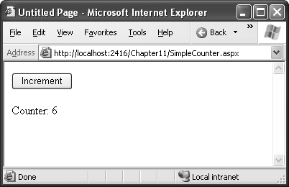
Simple View State Counter

Slide 8
Making View State Secure
view state information is stored in a single jumbled string that looks like this:
<input type="hidden" name="__VIEWSTATE" id="__VIEWSTATE" value="dDw3NDg2NTI5MDg7Oz4=" />
Because this value isn’t formatted as clear text, many ASP.NET programmers assume that their view state data is encrypted. It isn’t.

Slide 9
Tamperproof View State
in the web.config or machine.config file
<configuration>
<system.web>
<pages enableViewStateMac="false" />
...
</system.web>
</configuration>

Slide 10
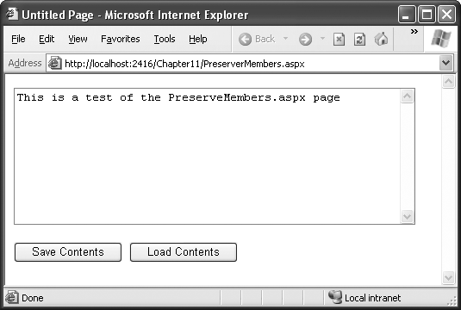
Retaining Member Variables

Slide 11
public partial class PreserveMembers : Page
{
// A member variable that will be cleared with every postback.
private string contents;
protected void Page_Load(Object sender, EventArgs e)
{
if (this.IsPostBack)
{
// Restore variables.
contents = (string)ViewState["contents"];
}
}
protected void Page_PreRender(Object sender, EventArgs e)
{
// Persist variables.
ViewState["contents"] = contents;
}
protected void cmdSave_Click(Object sender, EventArgs e)
{
// Transfer contents of text box to member variable.
contents = txtValue.Text;
txtValue.Text = "";
}

Slide 12
protected void cmdLoad_Click(Object sender, EventArgs e)
{
// Restore contents of member variable to text box.
txtValue.Text = contents;
}
}

Slide 13
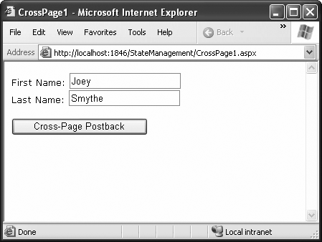
Transferring Information Between Pages

Slide 14
</head>
<body>
<form id="form1" runat="server" >
<div>
First Name:
<asp:TextBox ID="txtFirstName" runat="server"></asp:TextBox>
<br />
Last Name:
<asp:TextBox ID="txtLastName" runat="server"></asp:TextBox>
<br />
<br />
<asp:Button runat="server" ID="cmdPost"
PostBackUrl="CrossPage2.aspx" Text="Cross-Page Postback" /><br />
</div>
</form>
</body>
</html>

Slide 15
Transferring Information Between Pages
public partial class CrossPage2 : System.Web.UI.Page
{
protected void Page_Load(object sender, EventArgs e)
{
if (PreviousPage != null)
{
lblInfo.Text = "You came from a page titled " +
PreviousPage.Title;
}
}
}

